Slide 1

CSC 2302/DSCI 1302 Algorithms and Runtime Analysis

Slide 2
What is an algorithm?
An algorithm is a sequence of well-defined steps to accomplish a task.
- takes some value, or set of values, as input
- produces some value, or set of values, as output.
Inputs
Algorithm
Outputs

Slide 3
Properties of algorithm
Input and Output
Finiteness – number of steps
Determinism – produce same output for the same input
Efficiency – time and space
Correctness – produce expected output for valid inputs

Slide 4
Why algorithm?
Search Engines
Recommendation Systems
Image and Speech Recognition
Computer Vision
Robotics
Machine Learning
And many more …

Slide 5
Finding Efficiency of an Algorithm
One possible solution – Experimental Study
Execute an algorithm on various test inputs and recording the time spent during each execution
In Python, it can be done using the time function of the time module
This function reports the number of sec/ms/us that have elapsed since a benchmark time known as the epoch (e.g. 1/1/1970)
We can determine the elapsed time by recording the time just before and after the algorithm

Slide 6
Finding Efficiency of an Algorithm
One possible solution – Experimental Study
from time import time
start_time = time() # record the starting time
# execute the algorithm here
end_time = time() # record the ending time
elapsed = end_time - start_time # elapsed time

Slide 7
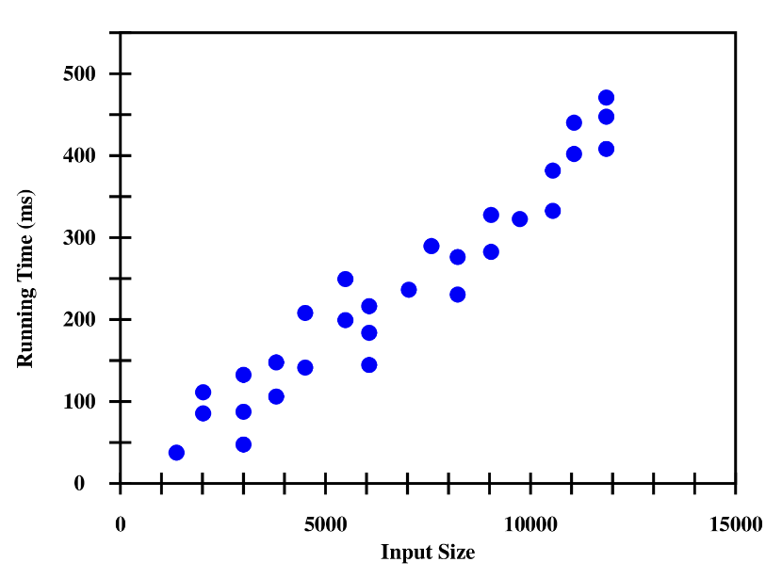
Finding Efficiency of an Algorithm
One possible solution – Experimental Study
We can then visualize the results by plotting input size vs elapsed time.

Slide 8
Finding Efficiency of an Algorithm
Limitations of Experimental Study
Experimental running times of two algorithms are difficult to directly compare unless the experiments are performed in the same hardware and software environments.
Experiments may be done only on a limited set of test inputs
An algorithm must be fully implemented to study its running time experimentally.

Slide 9
Finding Efficiency of an Algorithm
Moving beyond Experimental Analysis
Our goal is to find an approach to analyzing the efficiency of algorithms that:
is independent of the hardware and software environment
is performed by studying a high-level description of the algorithm without need for implementation
takes into account all possible inputs

Slide 10
Algorithm runtime
An algorithm's runtime is the time the algorithm takes to execute.
A function of the input size. f(n)
A sample algorithm
sum_v1(n)
1+2+3+ … +n # n steps
sum_v2(n)
n*(n+1)/2 # 1 step
Runtime varies based on your implementation!
1~n
sum_v1 / sum_v2
sum

Slide 11
Big-O notation
Big-O notation is a mathematical notation for upper-bounding a function's growth rate
Informally, can be found by ignoring constants and non-dominant growth terms.
Example:
f(n) = dominant + non-dominant + constant

Slide 12
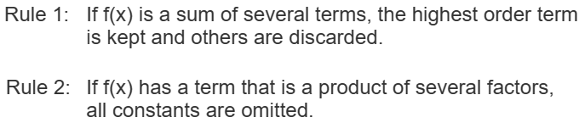
an²+bn+c=O(n²)
n + 137 = O(n)
n² + 3n – 2 = O(n²)
n³ + 10n²log(n) – 15n = O(n³)
2^{n} + n! = O(?)
O(n!)
O(1) < O(log n) < O(n) < O(n log n) < O(n²) < O(n³) < O(2^{n}) < O(n!)

Slide 13
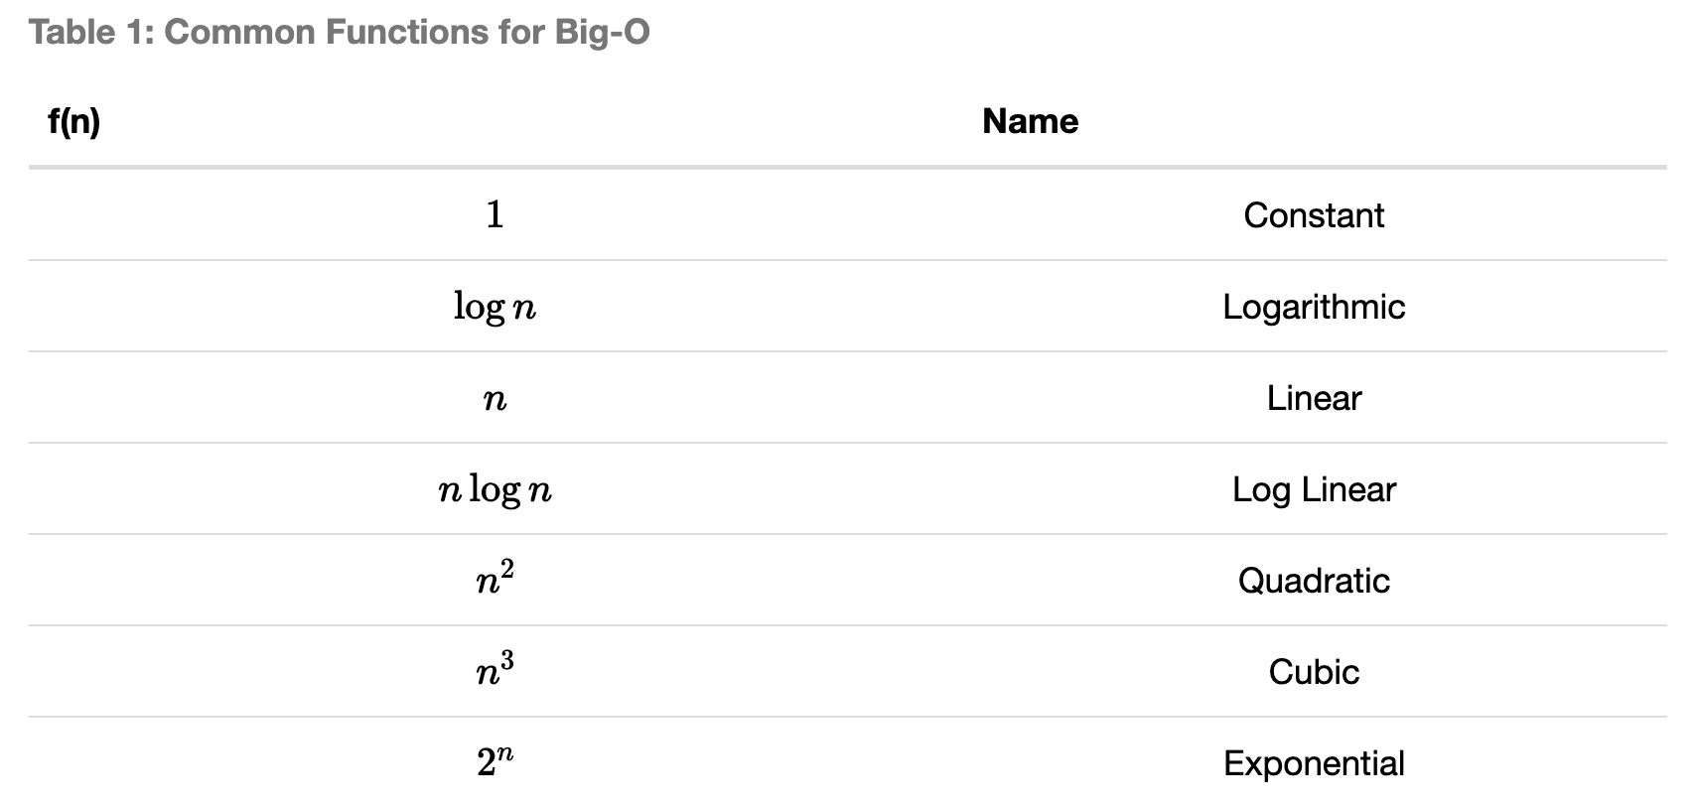

Slide 14
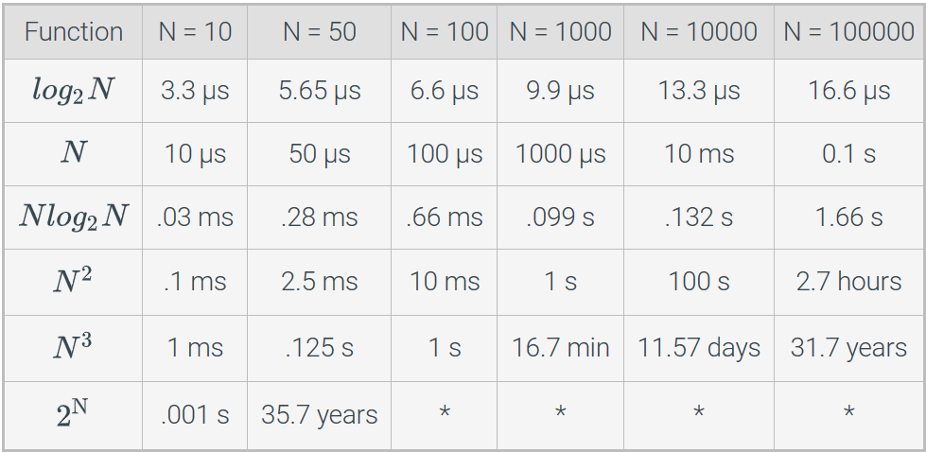
Growth rates for different input sizes

Slide 15
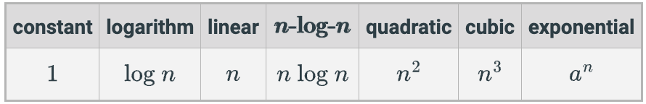
Ideal growth-rate / runtime?
Ideally, we would like:
Data structure operations to run in constant / logarithmic time.
Algorithms to run in <= log linear (nlogn) time.
Algorithms with quadratic or cubic running times are less practical.
Algorithms with exponential running times are only feasible for small
sized inputs.

Slide 16
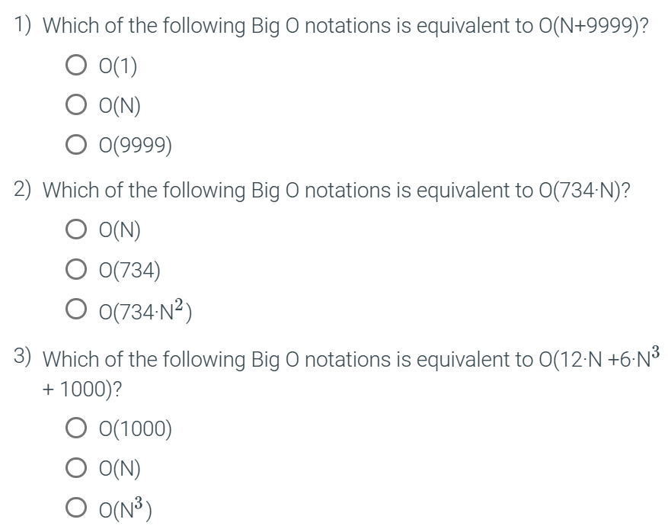


Slide 17
Algorithm Runtime Analysis
Best-case (Big Omega / Big Ω)
Cases
Average-case (Big Theta / Big θ)
Worst-case (Big Theta / Big O)

Slide 18
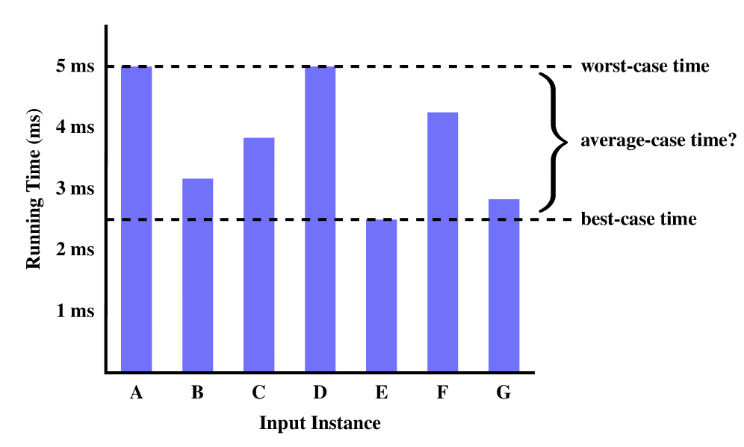
Algorithm Runtime Analysis

Slide 19
Best-case
Algorithm Runtime Analysis:
A situation where the algorithm performs optimally
Often represents the most favorable or ideal input for the algorithm
The best-case analysis helps us understand the lower bound on the algorithm's performance

Slide 20
Average-case
Algorithm Runtime Analysis:
Refers to the expected or typical performance of the algorithm on random or average input
Provides a more realistic assessment of the algorithm's efficiency
Determining the average-case runtime requires knowledge of the statistical properties of the expected data inputs.

Slide 21
Worst-case
Algorithm Runtime Analysis:
Refers to the scenario that causes the algorithm to perform the most poorly
Helps to understand the algorithm's behavior under unfavorable conditions
Algorithm runtime analysis often focuses on the worst-case runtime complexity

Slide 22
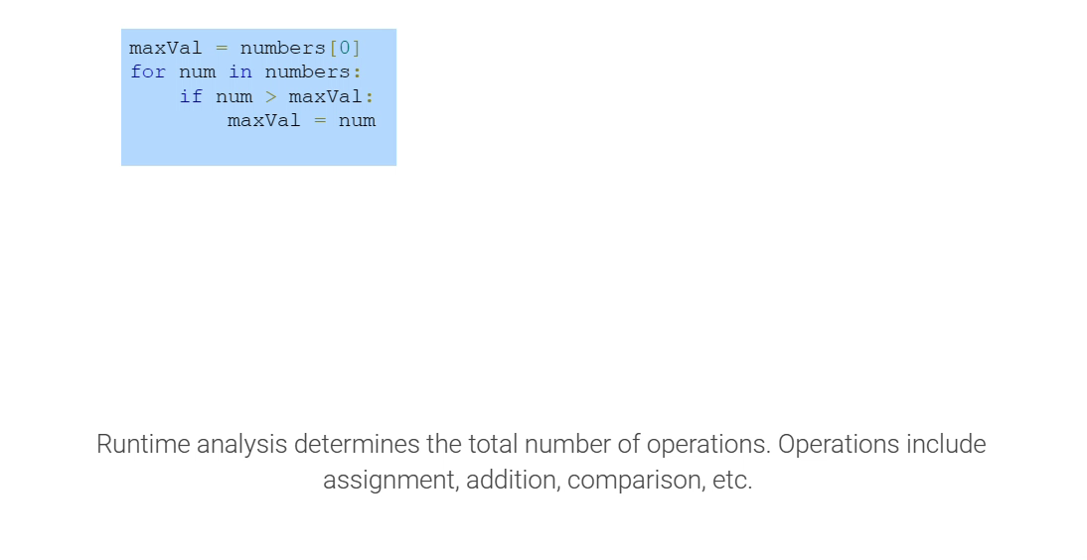
Analysis: Finding the max

Slide 23
Counting constant time operations
An operation can be any statement (or constant number of statements) that has a constant runtime complexity, O(1)
In big-O notation, any constant number of constant time operations is O(1)
Example:
Algorithm ~ 5 operations > 3 operations in the loop > 6 operation
~ 5 + 3N + 6
~ O(1) + O(N) + O(1)
~ O(N)

Slide 24
Space Complexity
An algorithm’s space complexity is the space the algorithm takes to execute relative to the input.
A function of the input size. f(n)
The space that doesn’t depend on input size, is often considered O(1)

Slide 25
Space Complexity – O(1) / constant
def print_list(arr): for num in arr: print(num)

Slide 26
Space Complexity – O(n )
def reverse_list(arr): n = len(arr) rev_arr = [] # additional space for i in range(n): rev_arr.append(arr[n-i-1]) return rev_arr

Slide 27
Space Complexity – O(n^2 )
def get_2d_zeros_list(n): res = [] # additional space for i in range(n): row = [] for j in range(n): row.append(0) res.append(row) return res

Slide 28
Exercises – Find the Big O time complexity

Slide 29
Exercise 1
def print_greetings(): print('Hello') print('World') print('!')

Slide 30
Exercise 2
def print_arr(arr): for i in range(len(arr)): print(arr[i])

Slide 31
Exercise 3
def perform_arithmetic_operations(a,b): add_res = a + b sub_res = a - b mul_res = a * b div_res = a / b print(add_res, sub_res, mul_res, div_res)

Slide 32
Exercise 4
def count_vowels(s):
vowels = 0
for char in s:
if char in ["a", "e", "i", "o", "u"]: vowels += 1
return vowels

Slide 33
Exercise 5
def print_everything_10_times(arr):
for item in arr:
for i in range(10):
print(item)

Slide 34
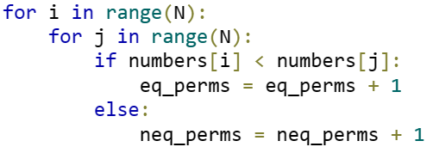
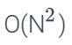
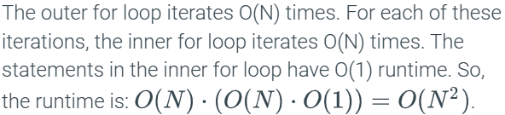
Exercise 6

Slide 35
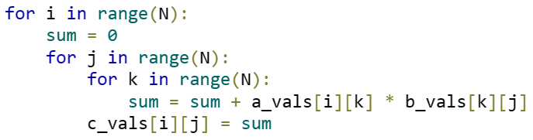
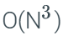
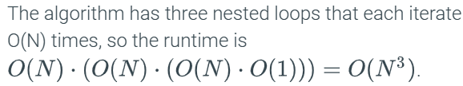
Exercise 7

Slide 36
Exercise 8
def square_numbers(nums): squared_nums = [] for num in nums: squared_nums.append(num * num) return squared_nums
Time Complexity ~ O(n)
Space Complexity ~ O(n)

Slide 37
Exercise 9
def generate_zeros_matrix(n): # Create an n x n matrix matrix = [] for i in range(n): row = [] for j in range(n): row.append(0) matrix.append(row) return matrix
Time Complexity ~ O(n²)
Space Complexity ~ O(n²)

Slide 38
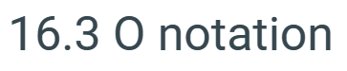
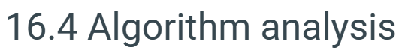
Recommended Reading from ZyBook:

Slide 39
Attendance

